Slide 1

Optimization Techniques Performed
ASHFAQ BAIG

Slide 2
Agenda:
Ray Implementation.
TensorRT Inference with Tensorflow.
Dynamic Batching
Post-training Quantization
Nividia DALI

Slide 3
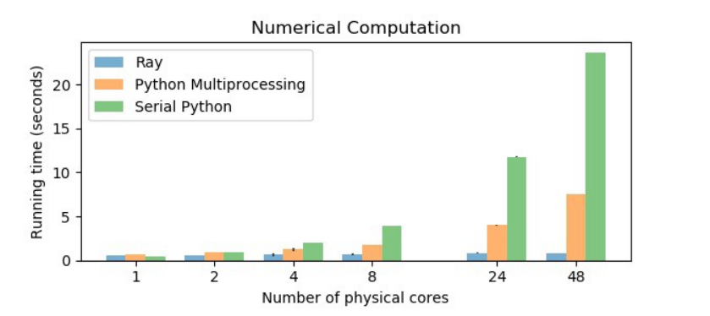
Ray Implementation
Ray is a fast, simple framework for building and running distributed applications that addresses these issues.

Slide 4
Ray Implementation
Implemented Ray by replacing multi-processing for decoding the byte array to numpy array in post-processing script.
Conducted experiment by running ED module locally by repeating it for multiple times and following metrics obtained.
I have seen optimization of ED time on toolchain by ~3secs/payload when I am running only one camera pipeline after including Ray implementation.
 | Model inference time | Post processing time | Pool time
Multi-processing | 3.14 sec | 5.1 sec | 4.15sec
Ray | 4.4 sec | 1.6 sec | 1 sec

Slide 5
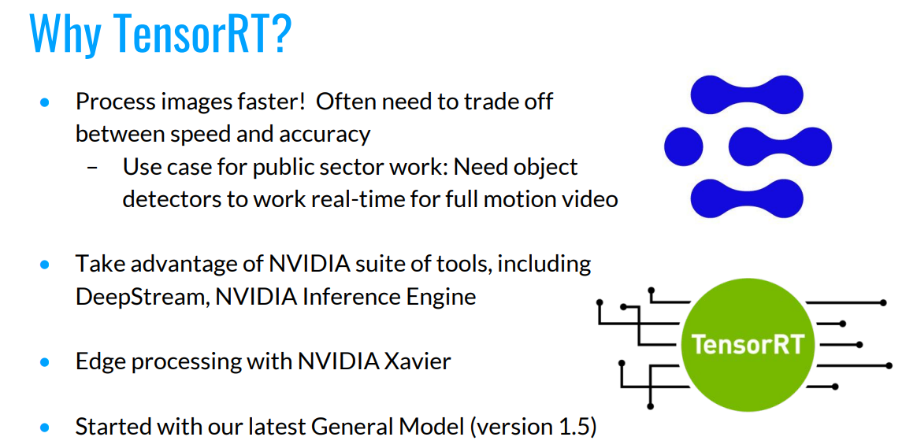
TensorRT Inference with Tensorflow

Slide 6
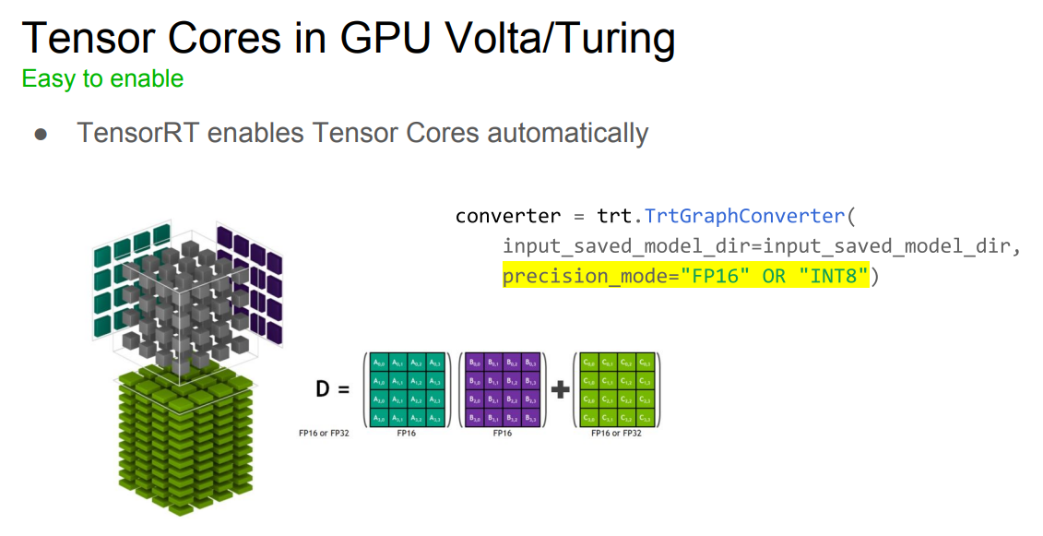
TensorRT Inference with Tensorflow
Tried to Convert model from Tensorflow to TensorRT but few nodes/ops/kernels are not able to convert in TensorRT format.

Slide 7
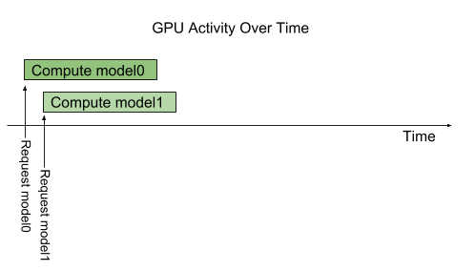
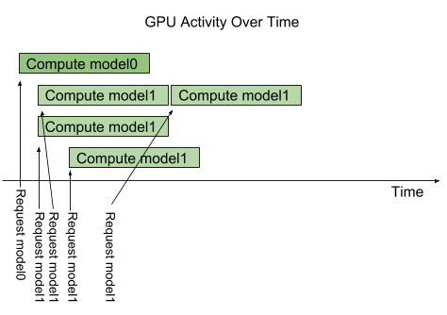
Dynamic Batching in Triton Server
Dynamic batching is a feature of Triton that allows inference requests to be combined by the server, so that a batch is created dynamically. Creating a batch of requests typically results in increased throughput.

Slide 8
Dynamic Batching in Triton Server
Used the Performance Analyzer to determine the latency and throughput provided by the default dynamic batcher configuration for Dexined model.
Figured out parameters to set in triton server(config file) for maximum throughput.

Slide 9

Post Training Quantization
Post-training quantization is a conversion technique that can reduce model size while also improving CPU and hardware accelerator latency, with little degradation in model accuracy.
Tried to quantize tensorflow model using graphdef but we have seen degradation of predictions.
We can use TF lite to quantize the model from FP32 to FP16 but TF lite format is not supported in triton server.

Slide 10
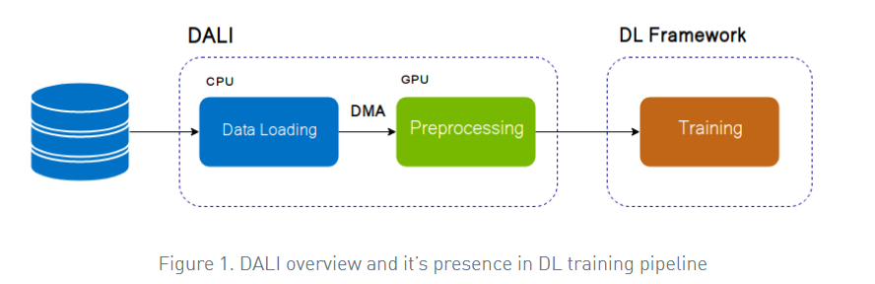
NVIDIA DALI
DALI is a set of highly optimized building blocks plus an execution engine to accelerate input data pre-processing for deep learning applications.
Tried to implement on ED but stitching needs to code in cuda C++

Slide 11
Numba JIT
Numba translates Python functions to optimized machine code at runtime using the industry-standard LLVM compiler library. Numba-compiled numerical algorithms in Python can approach the speeds of C or FORTRAN.
Implemented Numba JIT in preprocessing tile function and tested locally by running multiple times but not seen any optimization.

Slide 12
THANK YOU

